Slide 1

Library System
Amgalan Bat-Erdene
Saintur Batkhuu

Slide 2

Table of contents
Use Case Diagram
Class Diagram
Sequence Diagram
Demo
Extra Credit

Slide 3
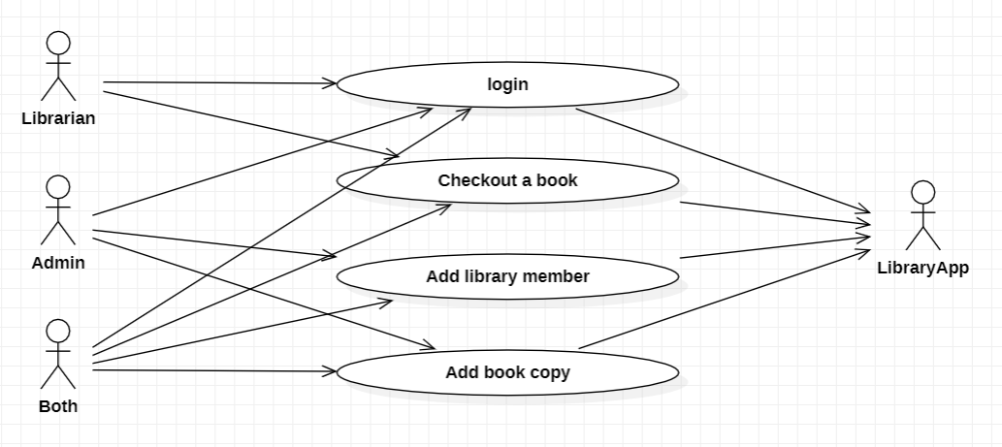
Use Case Diagram

Slide 4
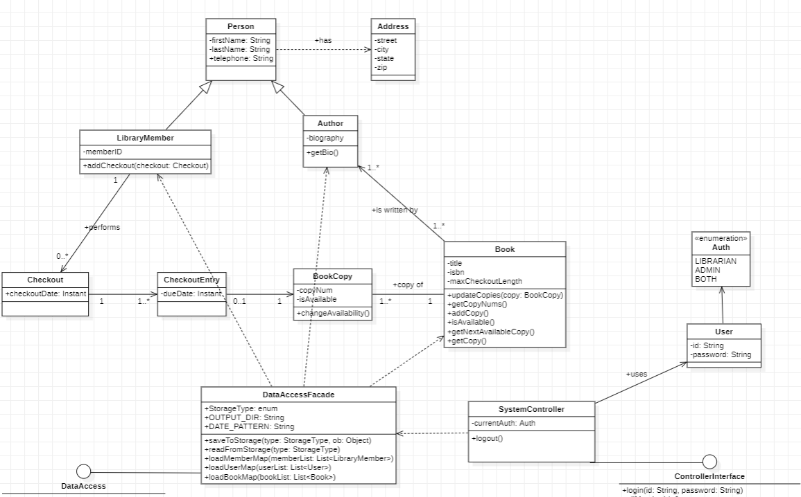
Class Diagram

Slide 5
Login Use Case
Use Action | System Response
1. Librarian/Admin/Both inputs username and password, clicks on Login button | 1. System validates username and password, shows main window

Slide 6
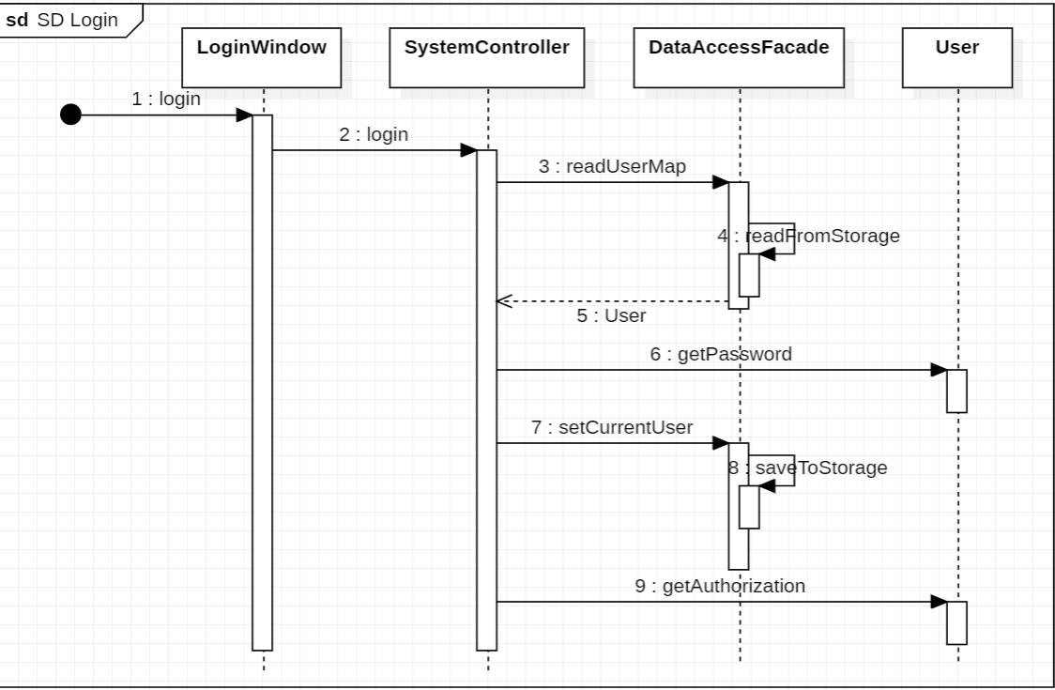

Slide 7
Add Library Member Use Case
Use Action | System Response
1. Admin inputs member info | 1. System validates all inputs
2. Admin select on “Add member” button | 2. System persists the new member to storage and return to main window

Slide 8
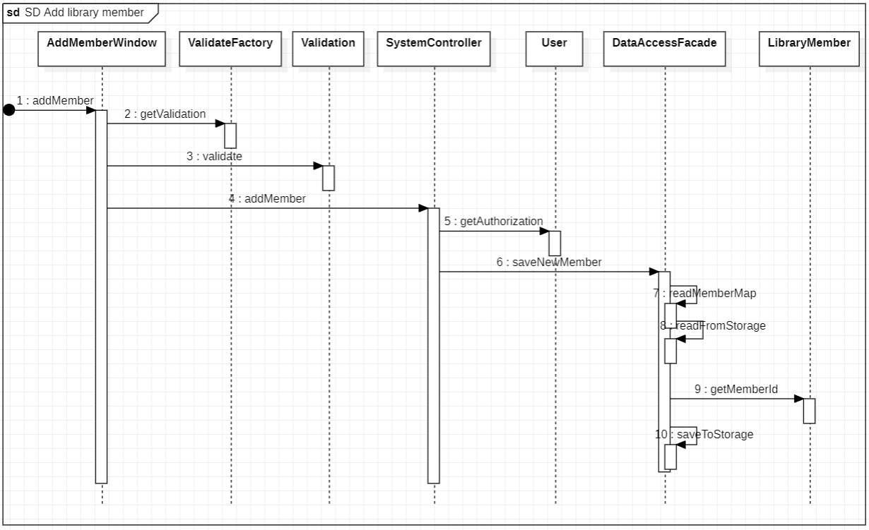

Slide 9
Checkout Use Case
Use Action | System Response
1. Librarian inputs ISBN and click “Search” button | 1. System checks ISBN from storage and displays available copies
2. Librarian select book copy to checkout and clicks add “>” button | 2. System add book copy to checkout list and displays
3. Librarian clicks “checkout” button | System checks out and returns to main display

Slide 10
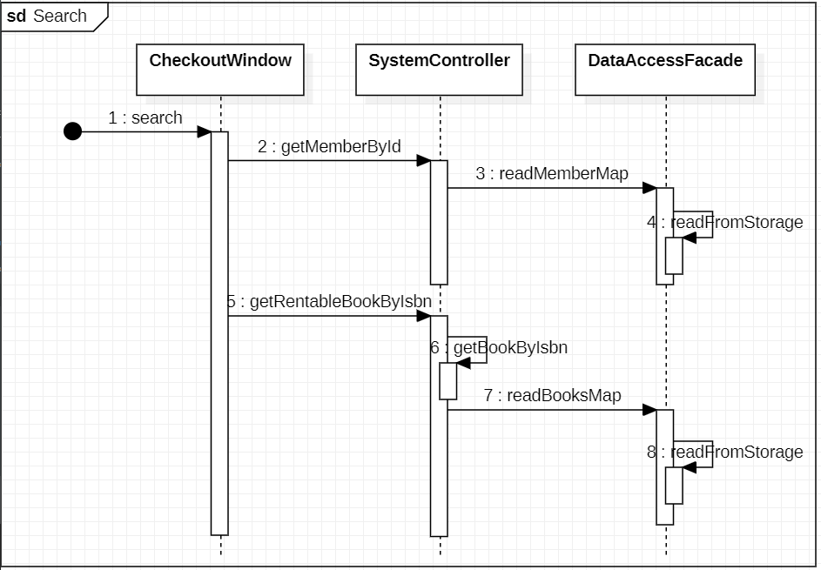

Slide 11
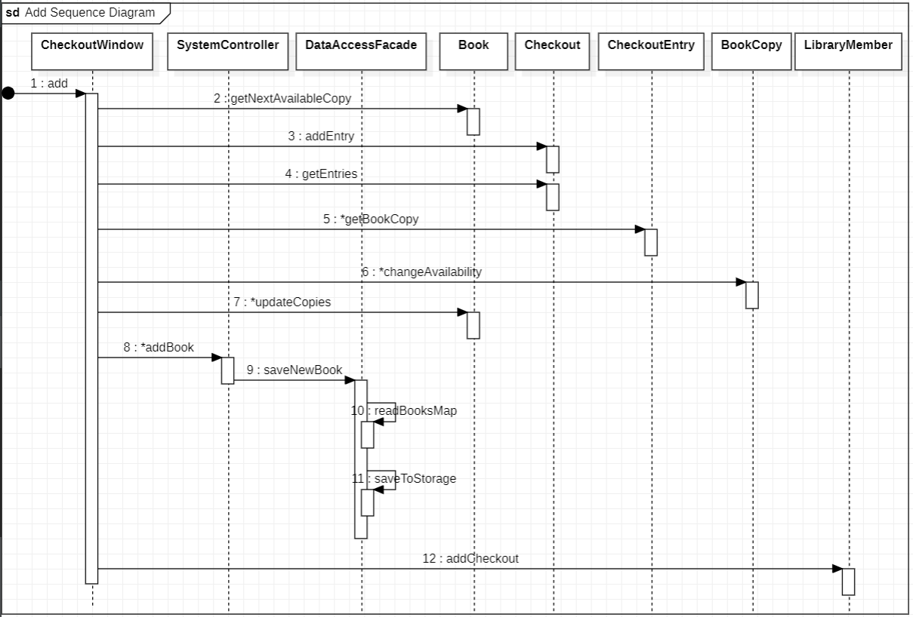

Slide 12
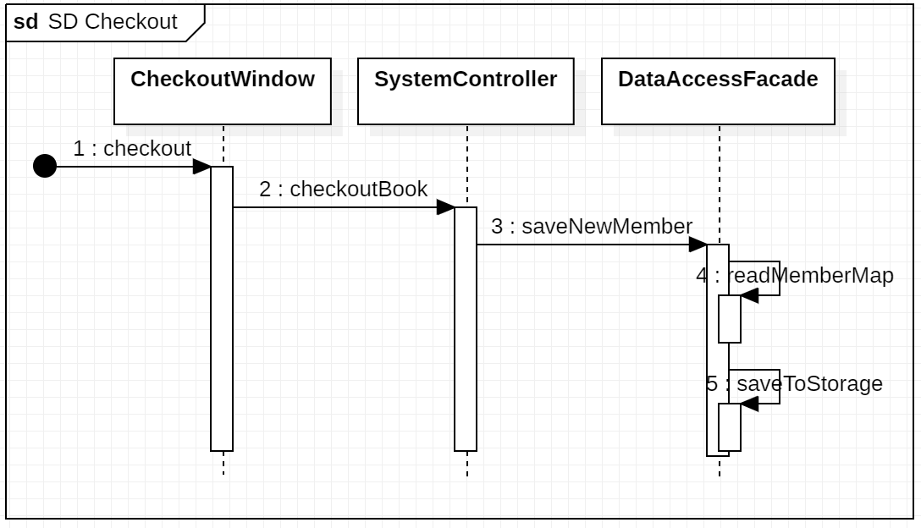

Slide 13
Add Book Copy Use Case
Use Action | System Response
1. Admin inputs ISBN and number of copies | 1. System validates all inputs
2. Admin select on “Add book copy” button | 2. System adds copies to book and persists to storage and return to main window

Slide 14
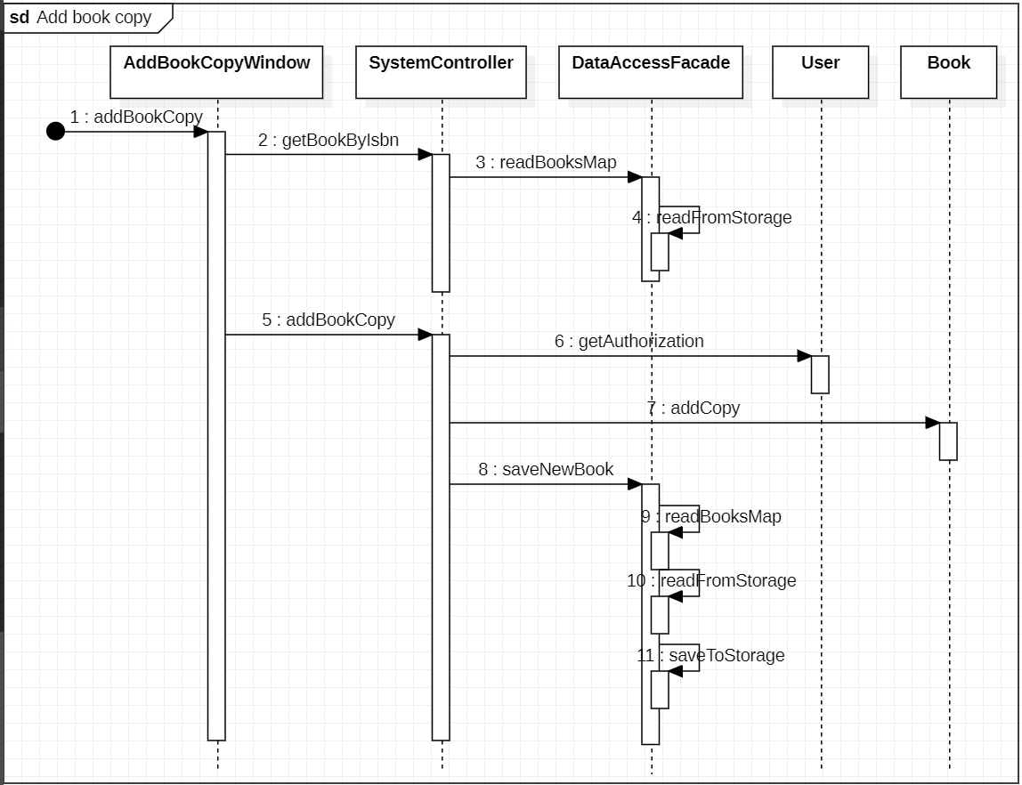

Slide 15
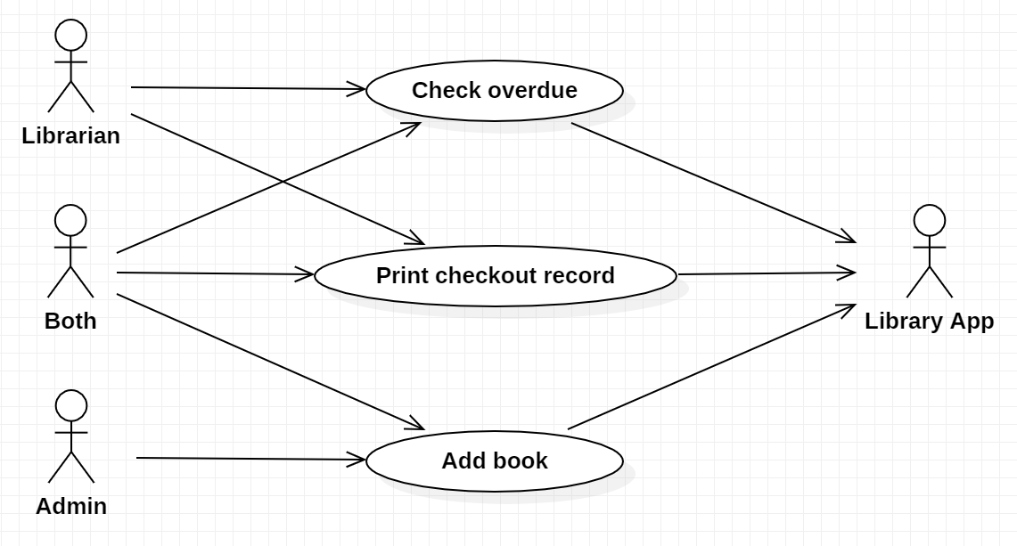
Extra Credit Use Case

Slide 16
Add Book Use Case
Use Action | System Response
1. Admin inputs book info and selects authors | 1. System validates all inputs
2. Admin select on “Add book” button | 2. System persists book to storage and return to main window

Slide 17
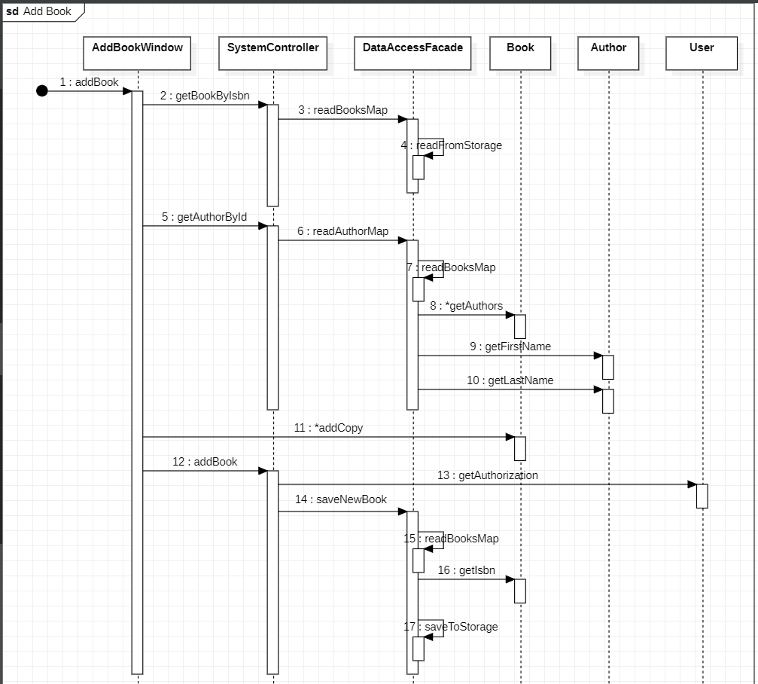

Slide 18
Print checkout record Use Case
Use Action | System Response
1. Librarian inputs memberID and click “Search” button | 1. System gets member checkout record and displays table view
2. Librarian click on “Printout” button | 2. System prints member checkout record list to console

Slide 19
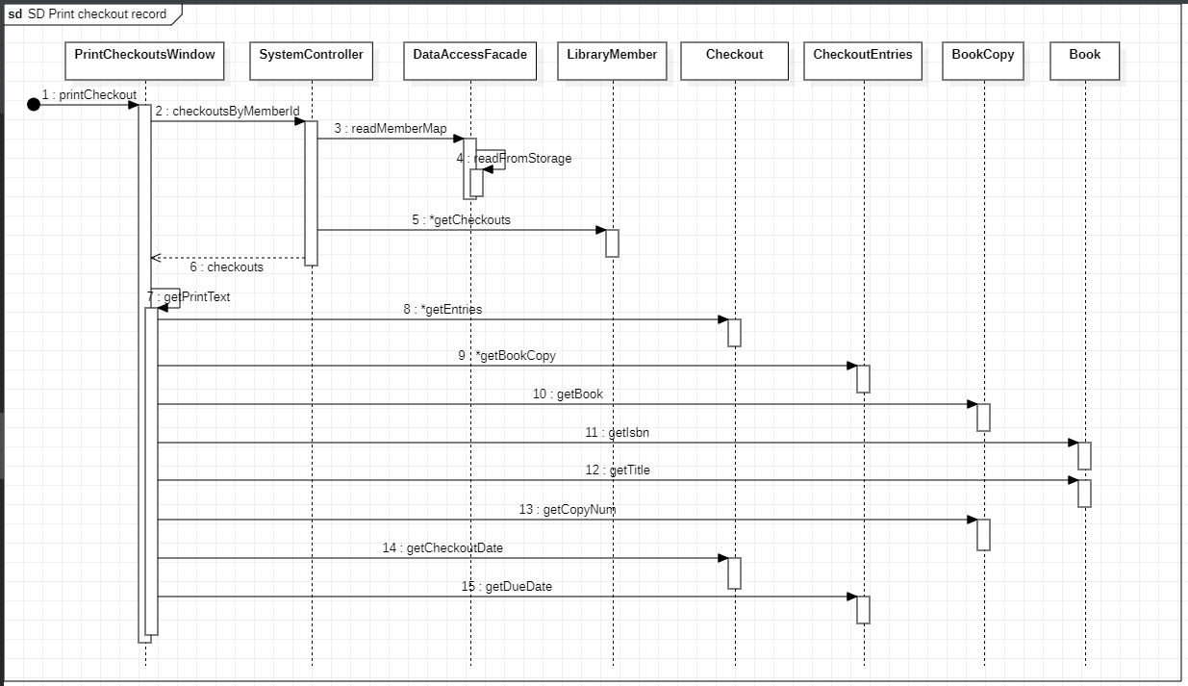

Slide 20
Check overdue Use Case
Use Action | System Response
1. Librarian inputs ISBN | 1. System validates input
2. Librarian click on “Search” button | 2. System prints member checkout record list to console

Slide 21
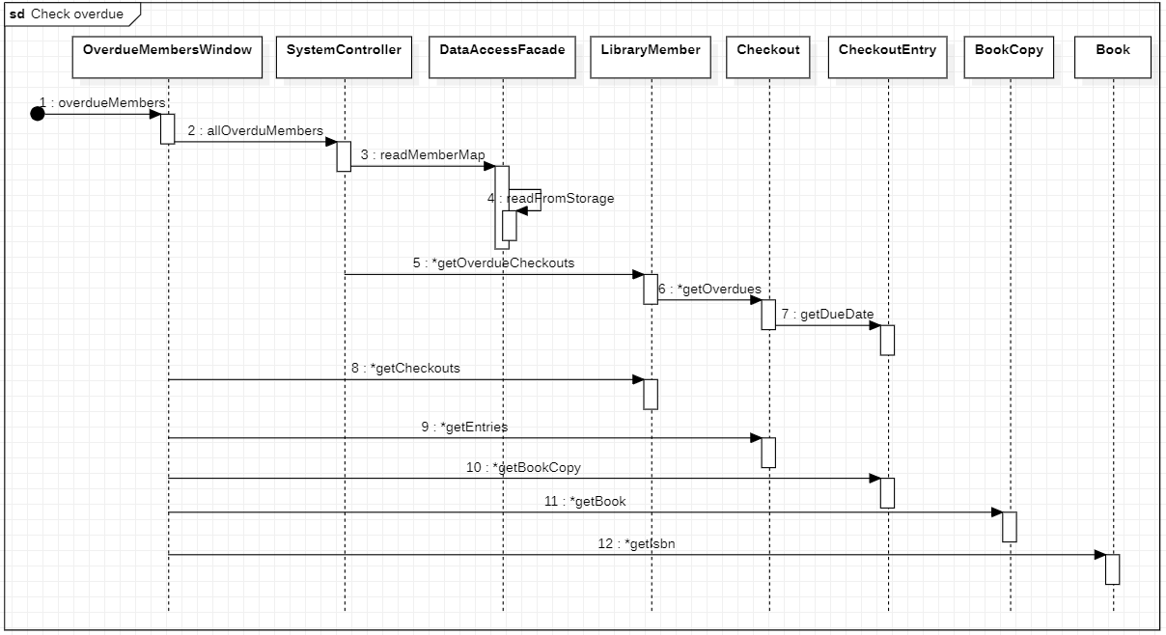

Slide 22

Thank you

